Slide 1
ON POINT MOBILE DETAILING
Lambo

Slide 2
Lambo Team
Zachary Baumgartner
Skyler Hewitt
Xiaotong (Sarah) Liu
Siqian (Jackie) Tong
Xuewei (Summer) Zhu

Slide 3

Current Website

Slide 4
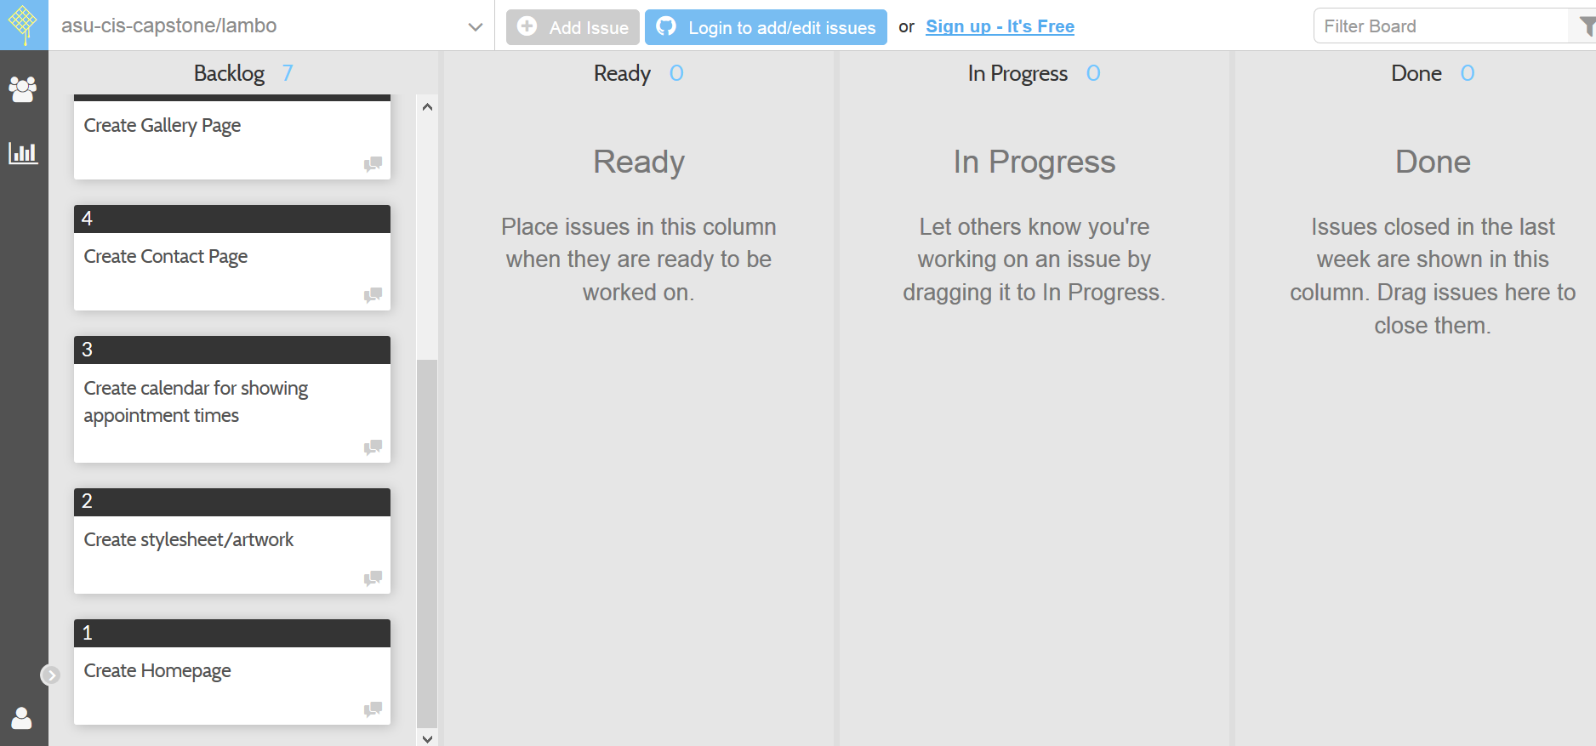
Project Backlog Items

Slide 5
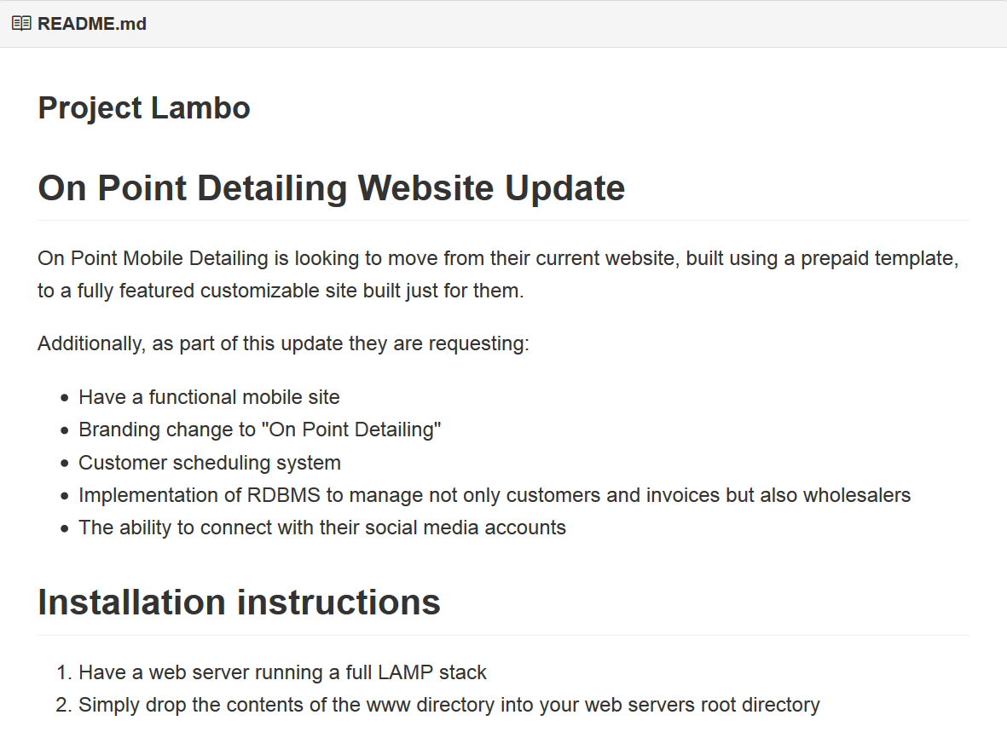
README.md File

Slide 6
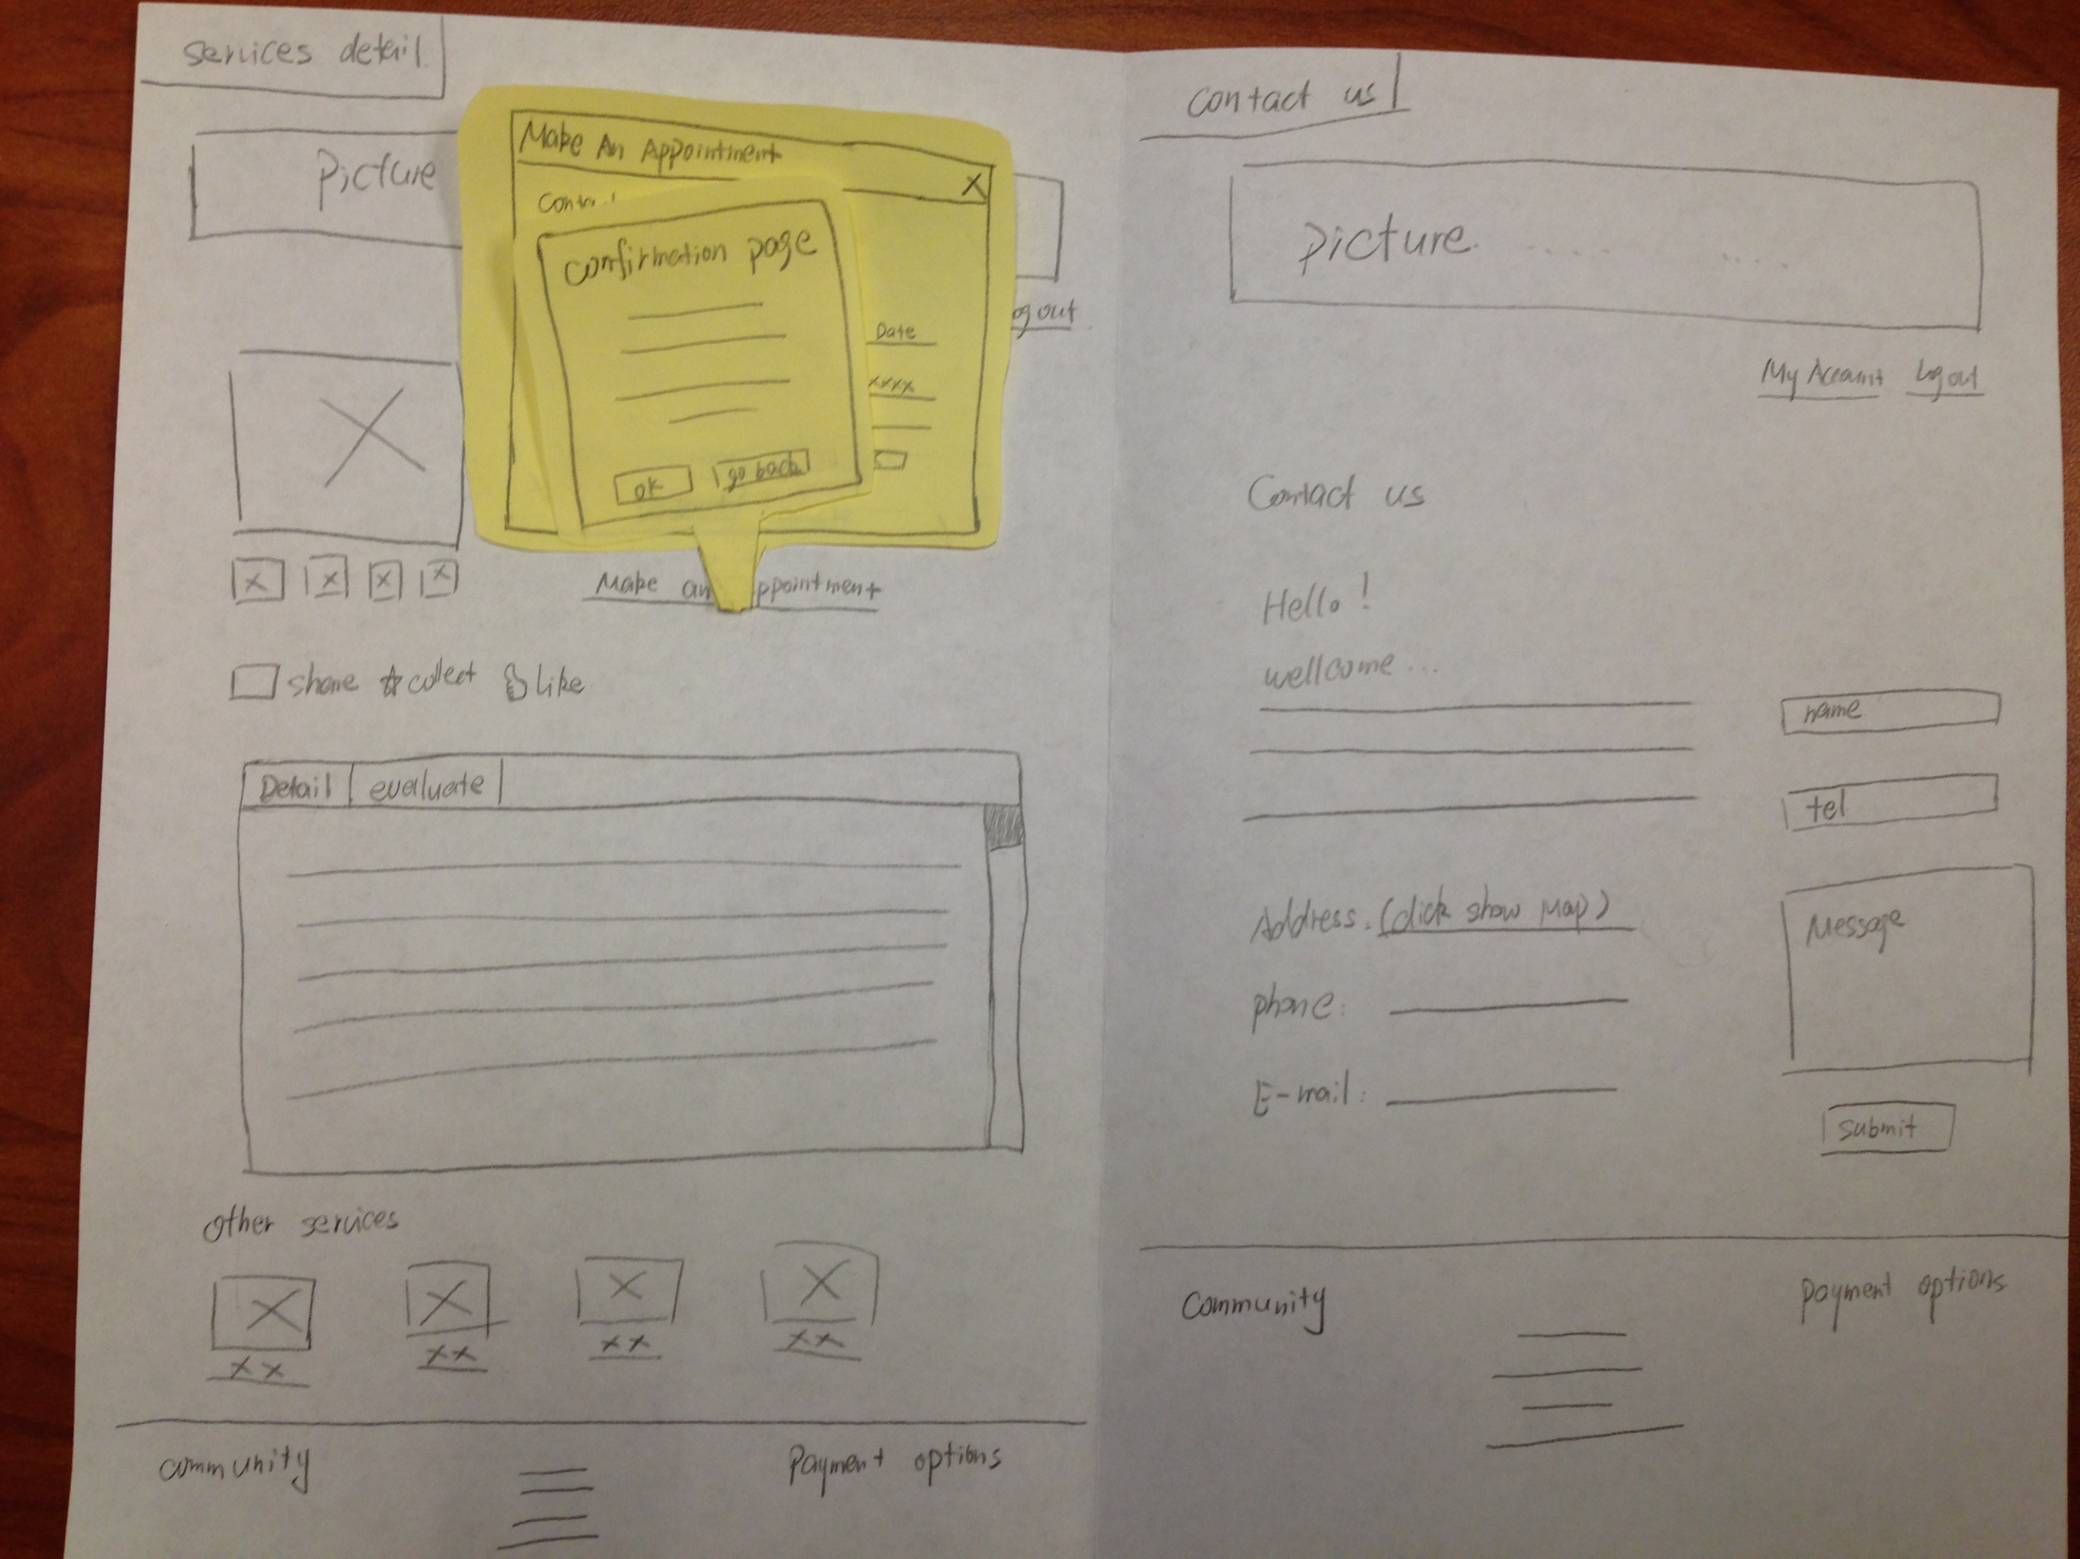
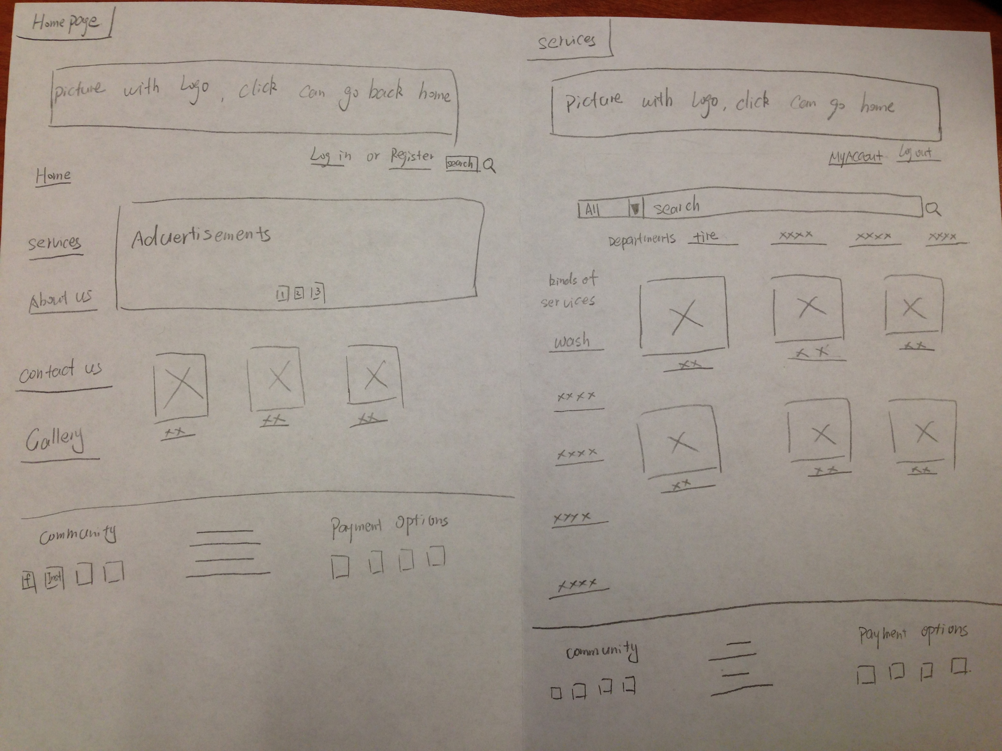
Paper Prototypes

Slide 7
We are Lambo
Thank you

